Slide 1

Fire and smoke detection
Devdarshan Mishra
Chinmaya Sahu
COE-AI LAB

Slide 2
Why the need?
Detecting fire or smoke at an early stage is a crucial to facilitate intervention in time to avoid large-scale damage.
Several methods and tools have been using to recognize fire or smoke in visual scenes.
Most of the traditional fire and smoke detection methods use sensor-based tools, which are supposed to detect the presence of the smoke or flame.
The main disadvantage of such sensors is that they can generally only recognize fire or flame near the places where they are installed, and this limits their effectiveness in large covered areas.
Therefore we propose to use deep learning as an effective solution to the above problem.

Slide 3
Possible ideas for implementation
We can annotate our own dataset of collected images and use YOLOv3 along with the CustomVideoObjectDetection class of imageai module to train our Fire Detection model.
The advantage of using yolo for training is that we would require less amount of data for achieving a good accuracy.
However the main disadvantage lies in the fact that data collection and annotation will take time since we need to manually draw the bounding boxes.
Processing of the frames of the input video is time consuming in nature.

Slide 4
Possible ideas for implementation
Second method that we can apply is to use available datasets consisting of images or videos for fire detection and then apply state of art models such as FireNet, Inception-onFire which are basically modified versions of GoogleNet, VGG, Alexnet etc.
The advantage of using the above method is that it is fast in detection and producing output once trained.
However the training task would require huge amount of data to avoid overfitting .
One more disadvantage is the system requirements. The models were trained on systems having 12 GB gpu and high specifications. However the pretrained models were released in the open source and can be used.

Slide 5
Libraries to be used
OpenCV
Numpy
Pandas
Matplotlib
Tensorflow
Streamlit
Imutils
Doc2unix
Darknet

Slide 6
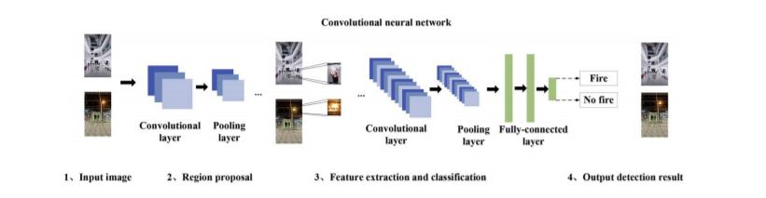
Basic work flow diagram

Slide 7
Our Proposed Solution
We used YOLOv3 algorithm to train our fire detection model for custom object detection.
We annotated our own collected images from the web and used them as a dataset to train our model.
Our dataset consisted of around 850 images which consisted of random fire images from google and images extracted from video frames.
We used DarkNet framework to train our model in google colab using its GPU support for over 10000 iterations and achieved an accuracy close to 75%.
We further built an interactive web app. over our model using streamlit to take images and videos as input and process them to detect fire.
The model is currently deployed in Heroku and can be observed by visiting this link .

Slide 8
Challenges faced by us
The data collection and annotation process was time consuming.
Fire doesn’t have any specified shape or size and even at times, varies in color, Hence achieving a high accuracy in its detection is a difficult task.
We first tried training on our local machines which took a lot of time and didn’t give much accuracy on training over less number of iterations and finally shifted to colab finding no other way.
Streamlit is a new framework and currently doesn’t have support for many python libraries.
Heroku when used as a free service doesn’t provide much ram due to which the frame rate is usually low while displaying the output.

Slide 9
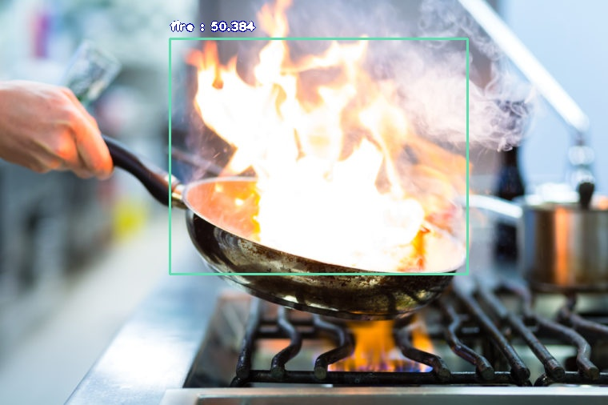
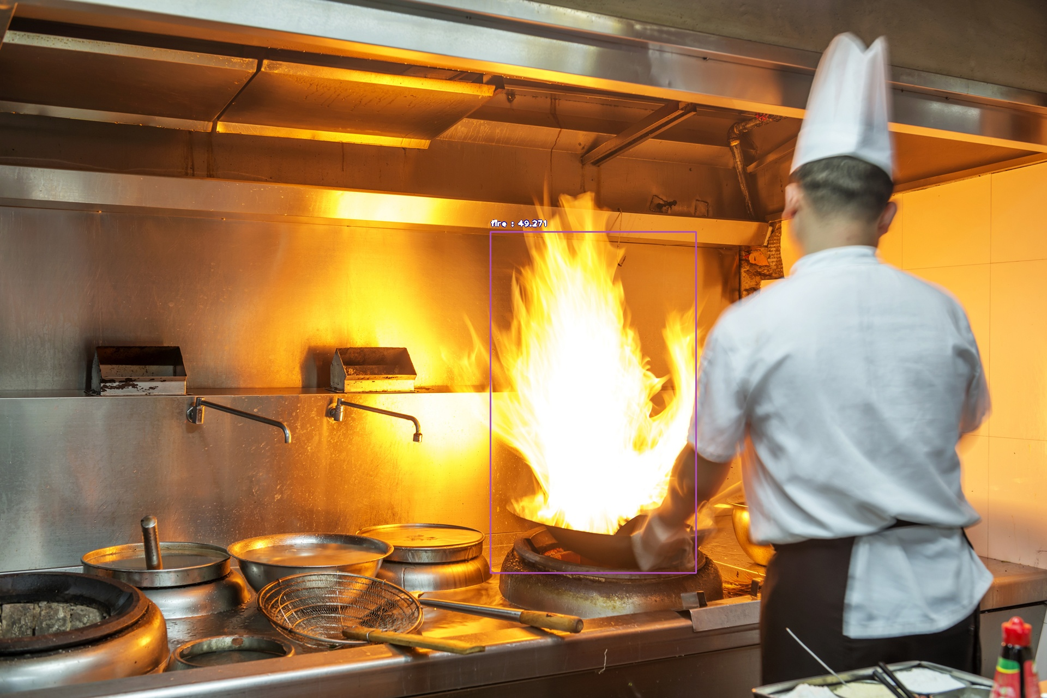
Expected Results

Slide 10
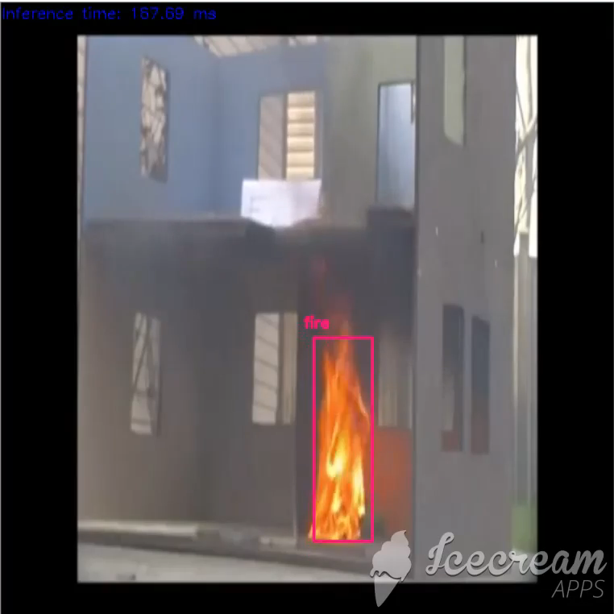
Results Obtained

Slide 11
Future Prospects
Work on Image augmentation techniques to solve the problem of overfitting on small dataset.
Work on improving accuracy of the model.

Slide 12
Conclusion
There has been number of studies in the field of fire detection providing us with enough resources to learn from and providing us with a scope for improvement.
The system shall be capable of continuously monitoring an area for fire detection without human interference and can warn through mails, text messaging or phone calls in case of detecting fire.
It is cheap and can provide accuracy along with automation.
It can be adopted as a safety measure in houses, factories, schools, theatres, malls etc.

